Slide 1

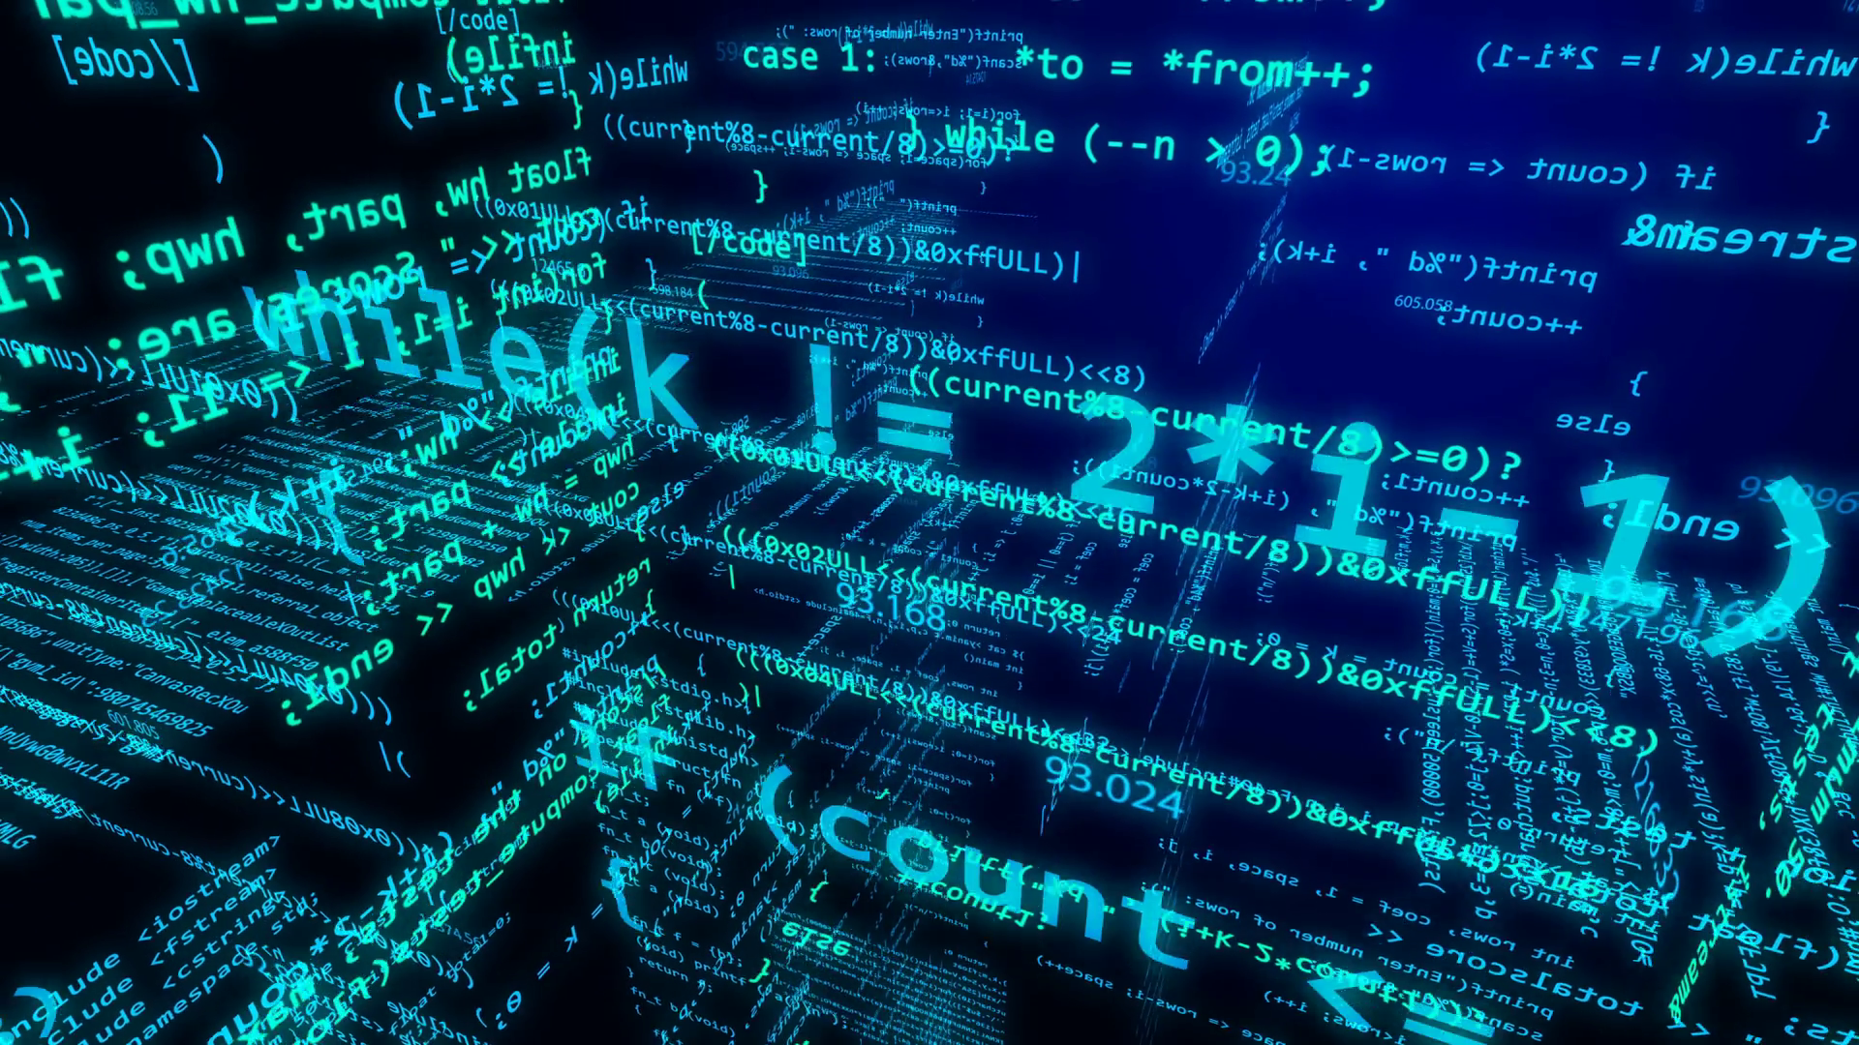
CodeBreakers

Slide 2
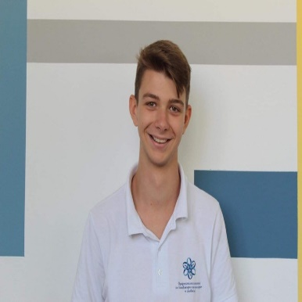
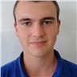
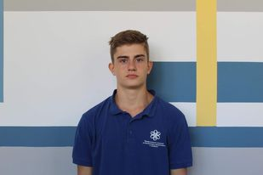
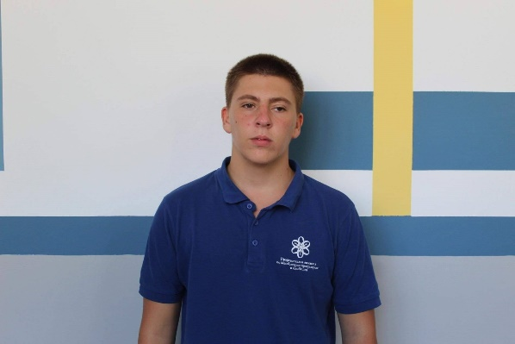
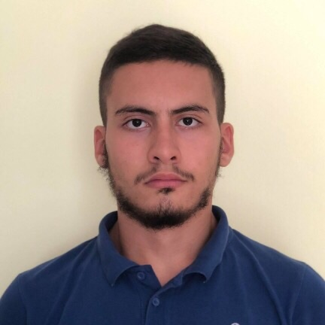
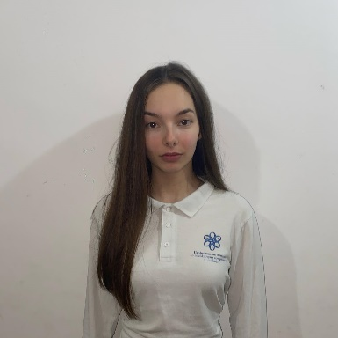
TEAM CODEBREAKERS
Stoyan Ponchev
Boyan Binev
Scrum Trainer
Q&A Engineer
Valentin Petrov
Dimitar Georgiev
Developer Frontend
Code Checker
Atanas Burmov
Raya Lilova
Developer Backend
Documentary

Slide 3




ABOUT THE PROJECT
And the process
Our project represents a program which helps the codebreakers to decode the coordinates of the German battleships so the allies will be able to track and destroy them. Also we offer site where the game can be downloaded.
For the process we considered the idea about our project then we have set a deadline for completing the tasks then we have allocated the tasks.

Slide 4





USED PROGRAMS
a

Slide 5
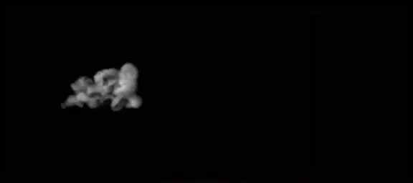
Thank you

